Slide 1
LINUX COMMANDS-DAY 4
ALEESHA JOJI
166574

Slide 2
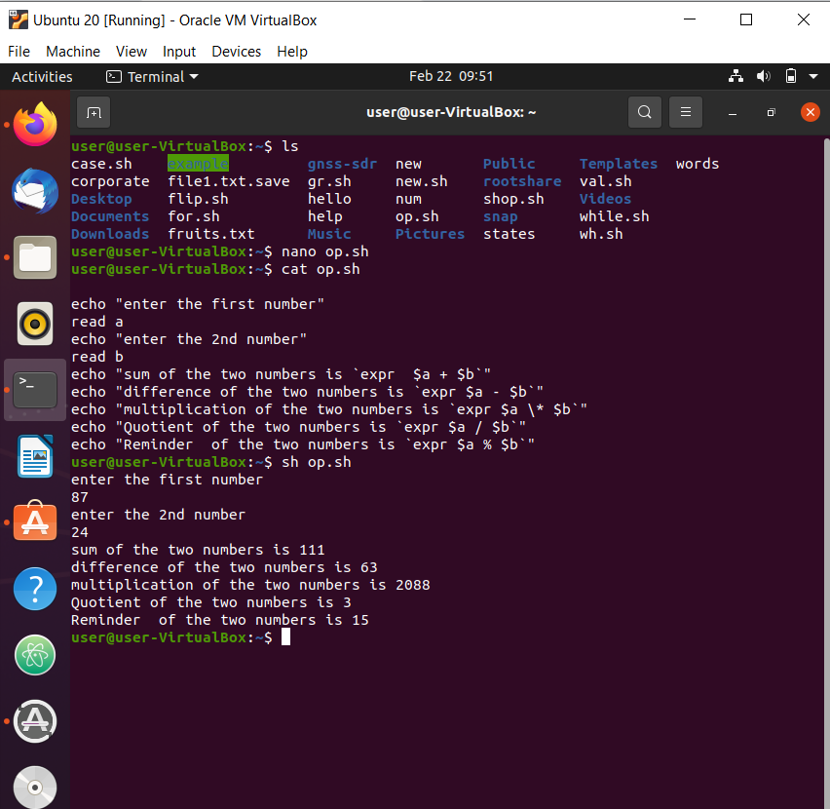
OPERATORS
ARITHMETIC -, +, / ,* ,%,= ,==, !=
BOOLEAN ! (negation inverts yes or no)
-o(or oprtn if one comand is true
then cndtn is true)
-a (AND oprtn)
Shown is a program created in Ubuntu for displaying
the various Boolean operations between two numbers.
The editor used is vi editor.

Slide 3
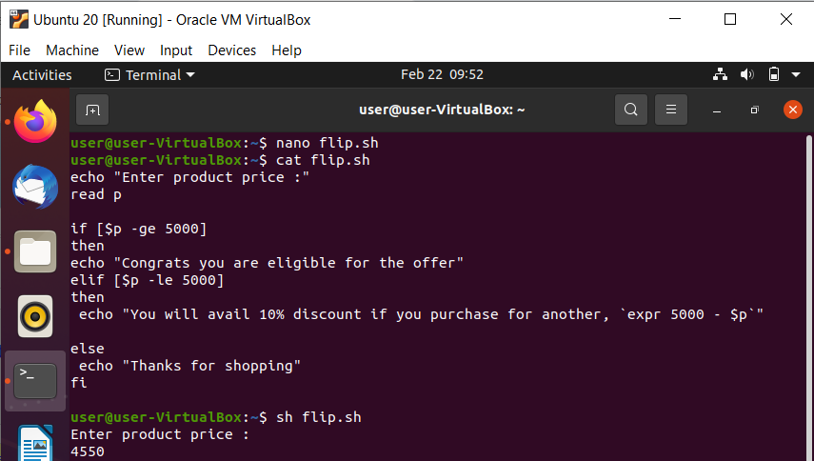

Slide 4
cat op.sh: Shows the full shell script
sh op.sh: Displays the output.
cat flip.sh: Shows the shell script
sh flip.sh: Displays the output
RELATIONAL -gt ,-lt ,-eq , -ne ,-ge , -le

Slide 5
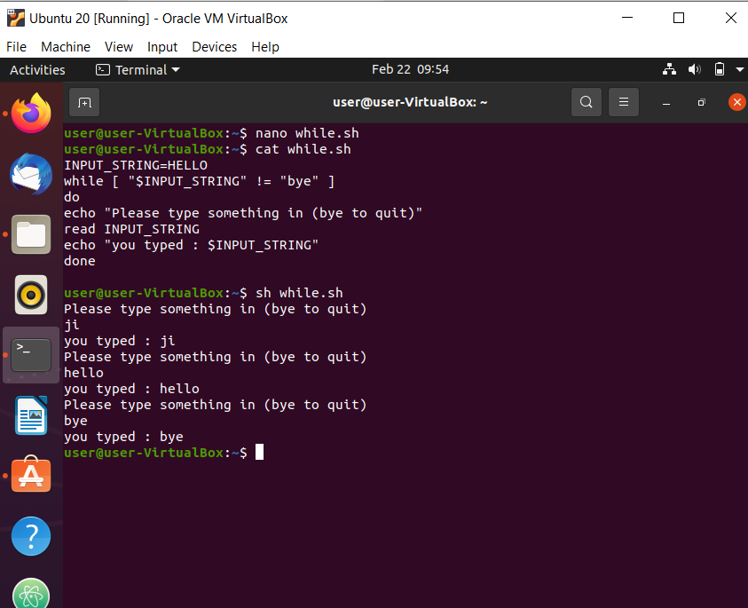

Slide 6
LOOPS
for
while
Shell script displaying the use of while loop.
Displayed here is a program which only quits when “bye” is given as an input.
Syntax: while [ expression]
do
statements
done

Slide 7
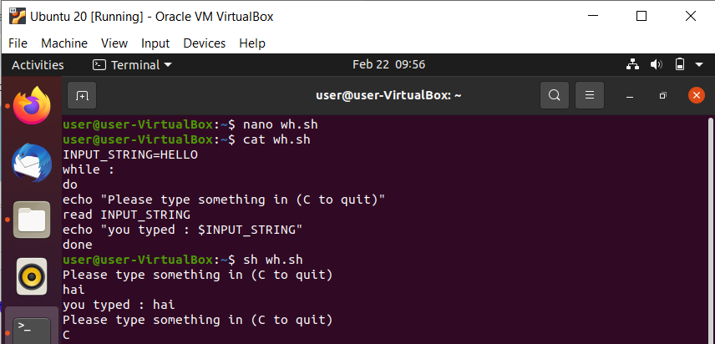

Slide 8
DECISION MAKING
if
if [ expression ]
then
line1
else
line2
fi
elif - else if

Slide 9
do while
Syntax: while [ expression]
do
case $a in …..
lines ;;
….. ;;
esac
done
until

Slide 10
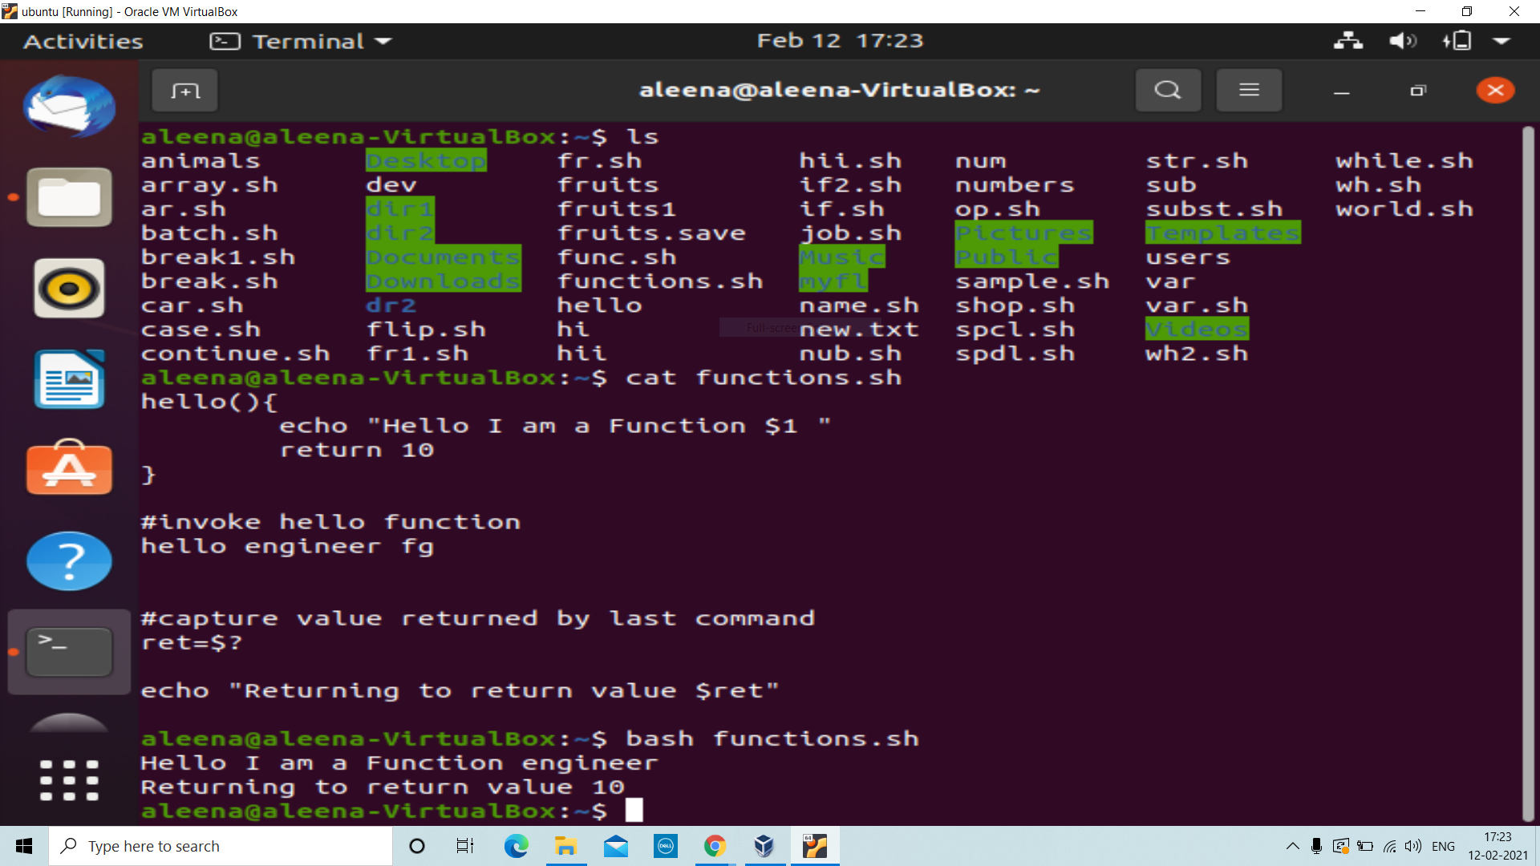

Slide 11
SHELL FUNCTIONS
functions are used to write reusable code
function_name()
{
…
<statements>
…
}

Slide 12
THANK YOU

